Slide 1
Brain Anatomy Inference with Differentiable MRI simulators
Razvan Marinescu
University of California, Santa Cruz

Slide 2
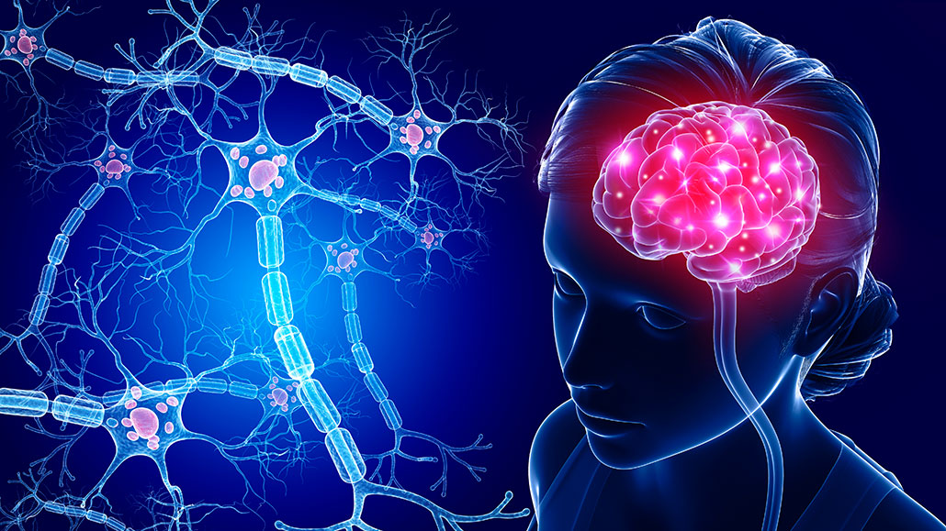
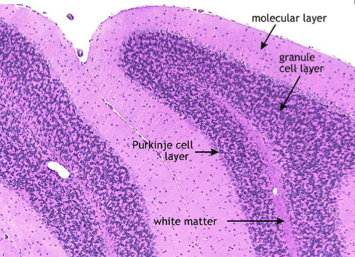
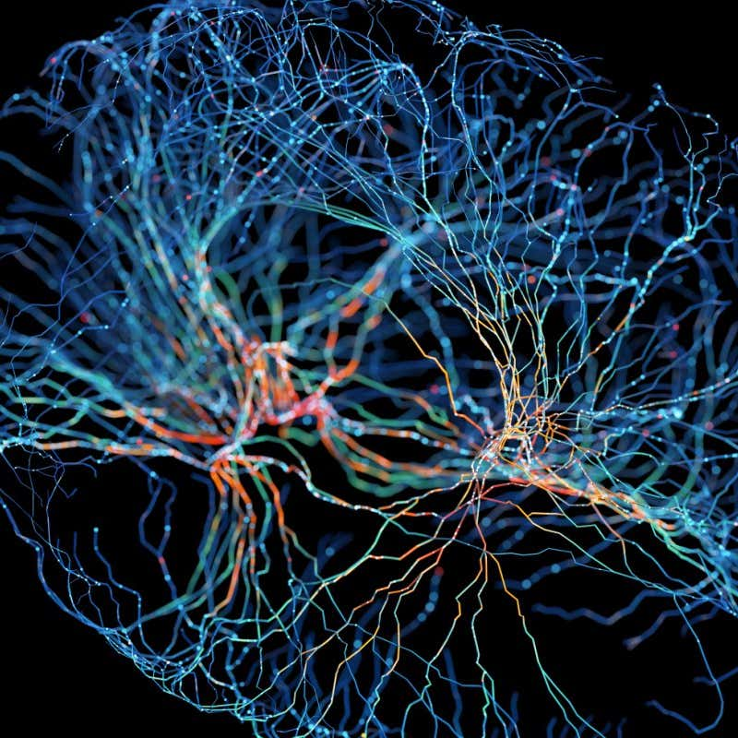
The dream of Magnetic Resonance Imaging in Neuroimaging
See inside the brain, map and measure every neuron
Like histology, but in-vivo!

Slide 3
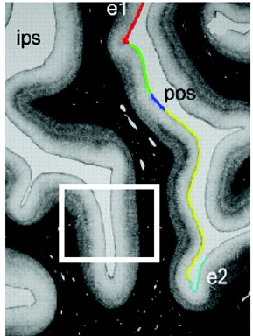
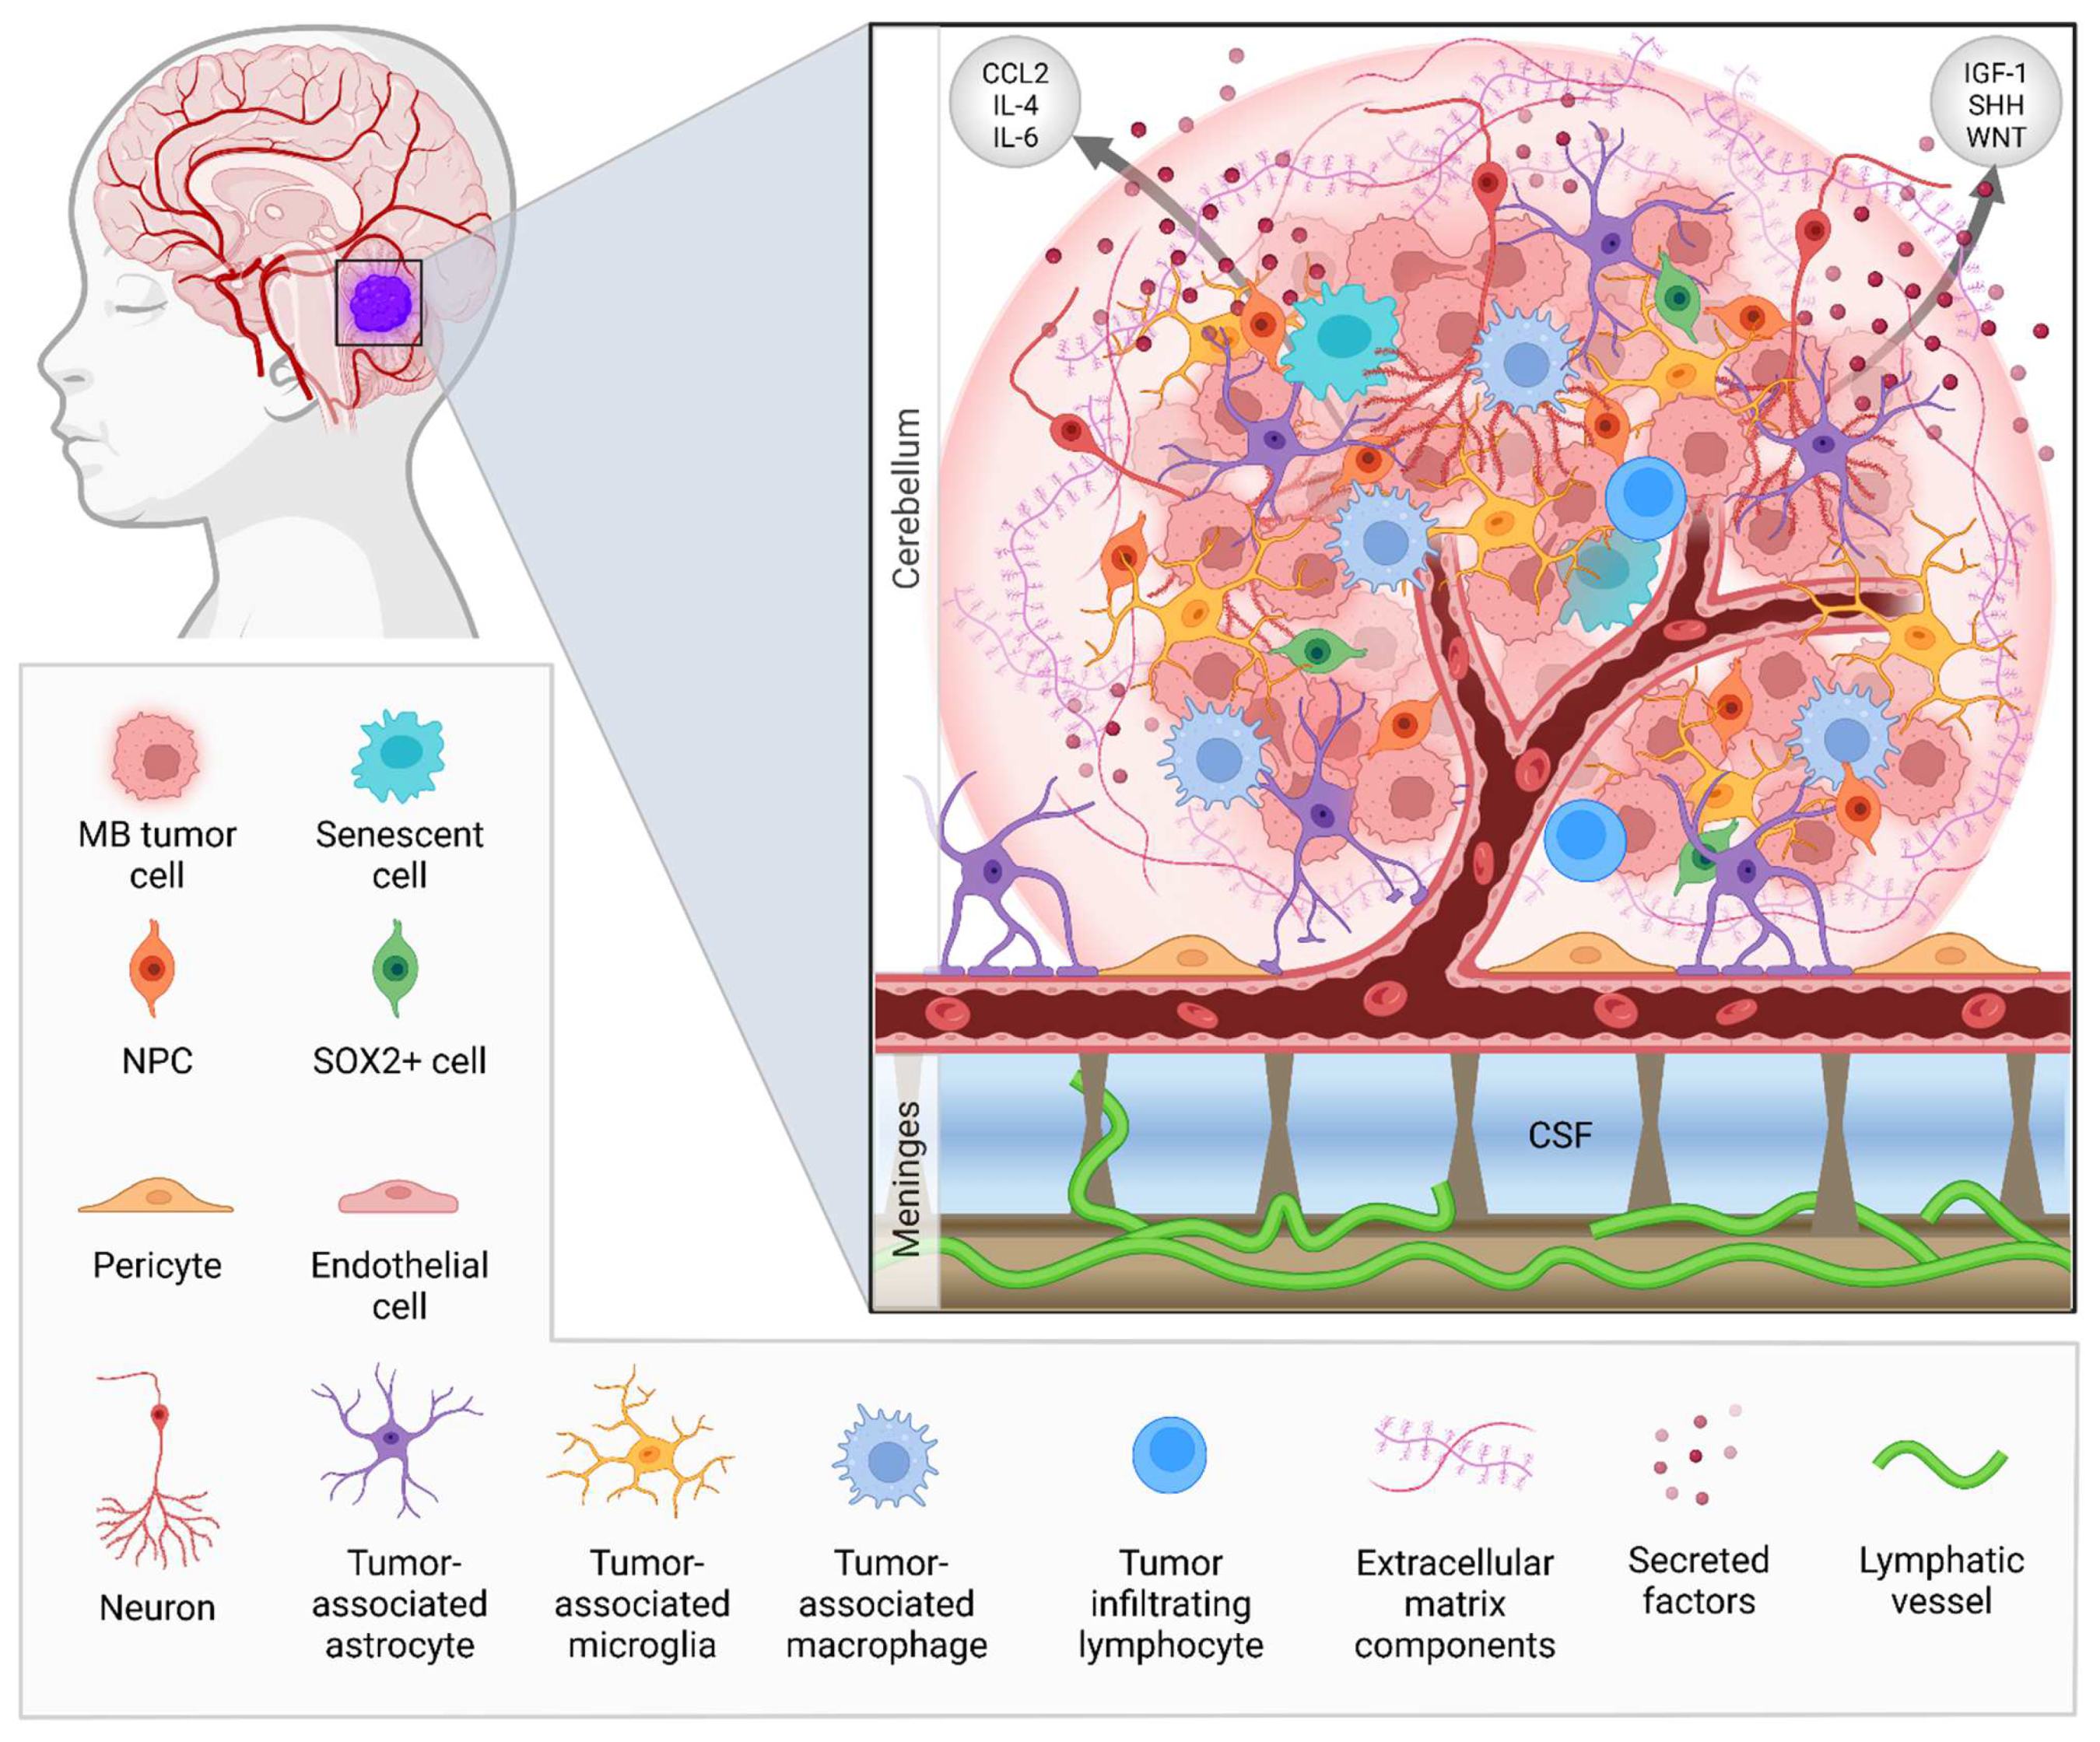
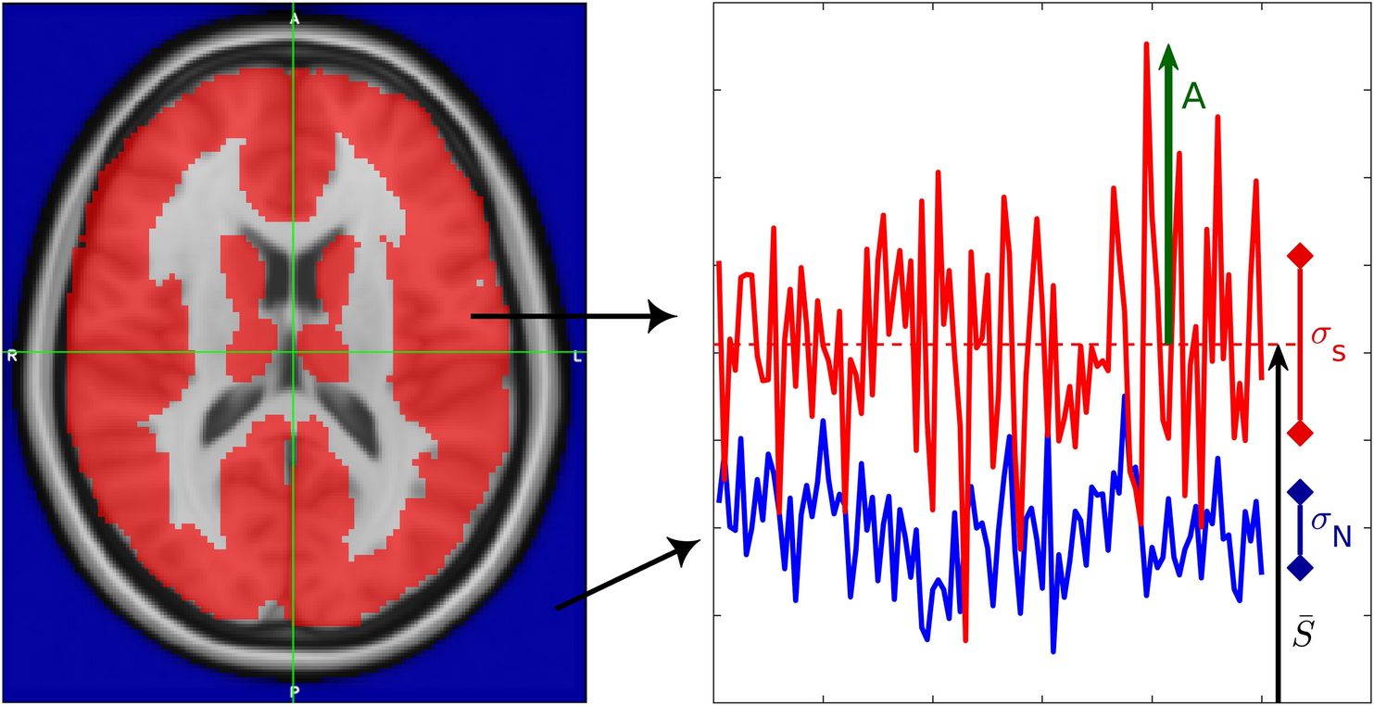
The dream of Magnetic Resonance Imaging
Detect sophisticated disease biomarkers at different scales
High-level: subtle boundaries between structures, sub-structures, cortical layers, …
Low-level: De-myelination, axonal degeneration,
Detailed mapping of tumour macro-/micro-environments
Direct, noise-free measures of functional activity

Slide 4
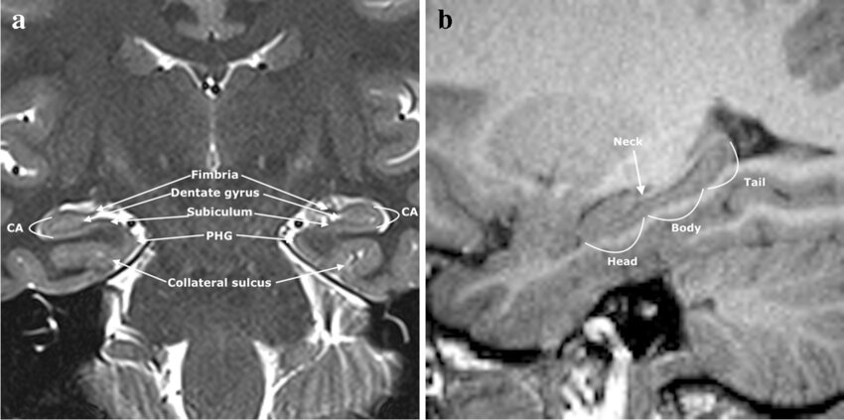
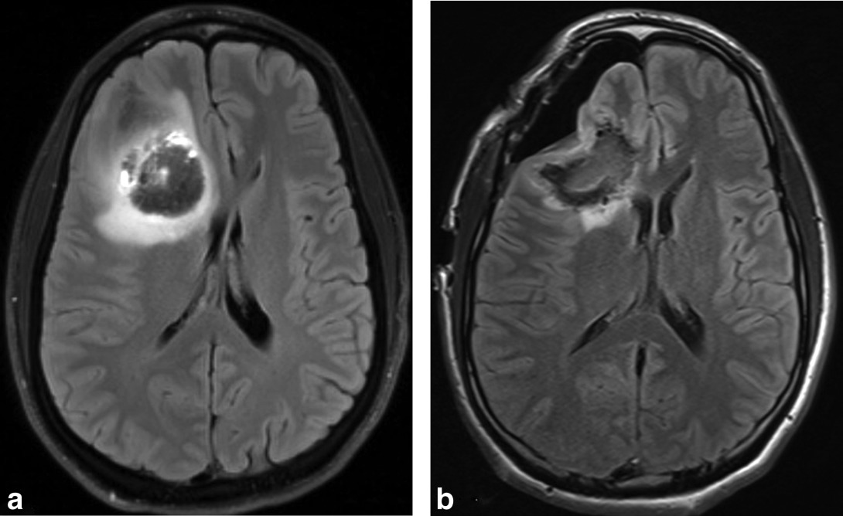
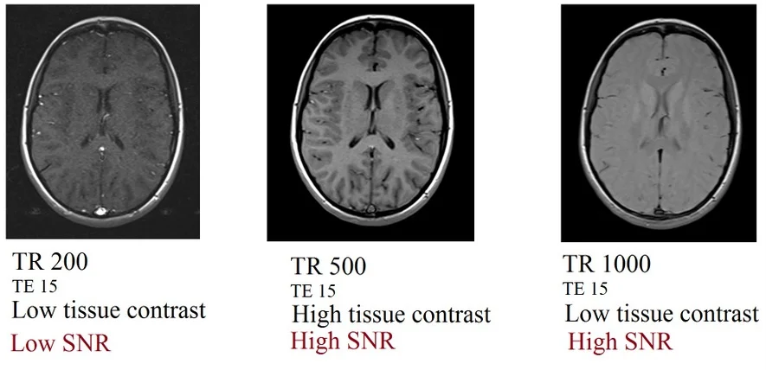
Current MRI technology has multiple shortcomings
Detection of cortical layers is difficult
Tumor environment can be mapped, but only to some extent
3T scan of 14-year old female with seizures
Hard to achieve high SNR in fMRI
Very far from mapping individual neurons!

Slide 5
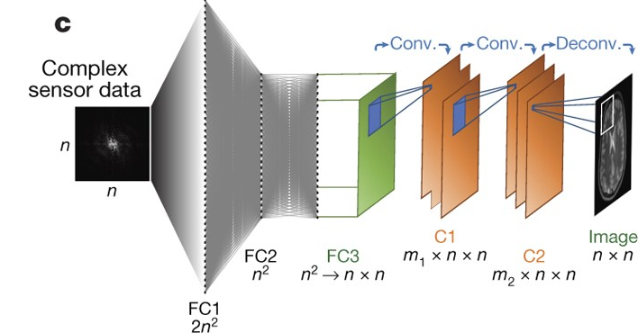
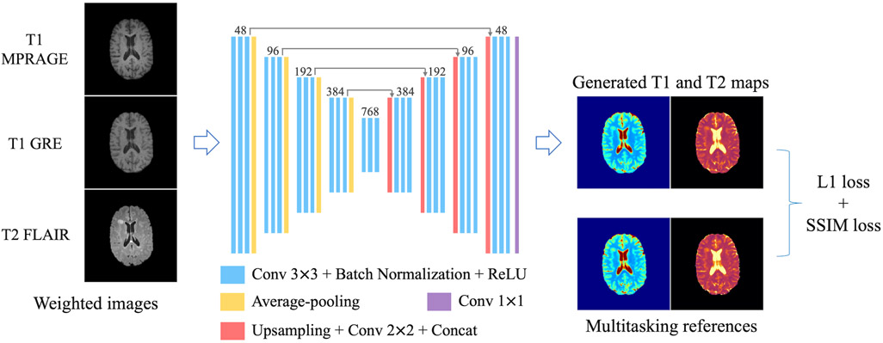
Machine Learning can help reconstruct MRI scans and infer underlying anatomy and function
Recon from (undersampled) k-space
Estimation of quantitative T1/T2/PD maps
AUTOMAP (Zhu et al, Nature 2018)
Qiu et al, MRM, 2022
However, why reconstruct only T1/T2-weighted scans, or quantitative T1/T2 maps. Why not reconstruct entire digital brain phantoms?

Slide 6
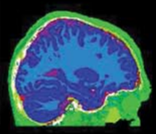
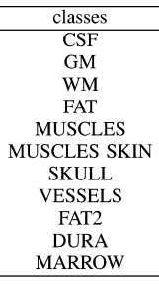
Achieving the MRI dream: digital brain phantoms
Aubert-Broche, IEEE TMI, 2006
A digital brain phantom ideally describes everything about the tissue anatomy, as well as cellular and molecular makeup
Deals with partial volume effects
A voxel contains % of each class tissue
Can include:
Cellular markers: myelination, packing density, % axons, % synapses, % glia, …
Molecular markers: concentration of amyloid, tau, alpha-synuclein, …)
Functional markers: metabolism levels, perhaps broken down by types of neurons (inhibitory/excitatory)
1 voxel

Slide 7
How can we learn patient-specific digital phantoms?
We cannot do supervised learning because:
we lack the phantoms themselves to train on
patients have different combinations of scans and sequences available (e.g. T1-weighted with certain)
Solution: MRI scanning simulators

Slide 8
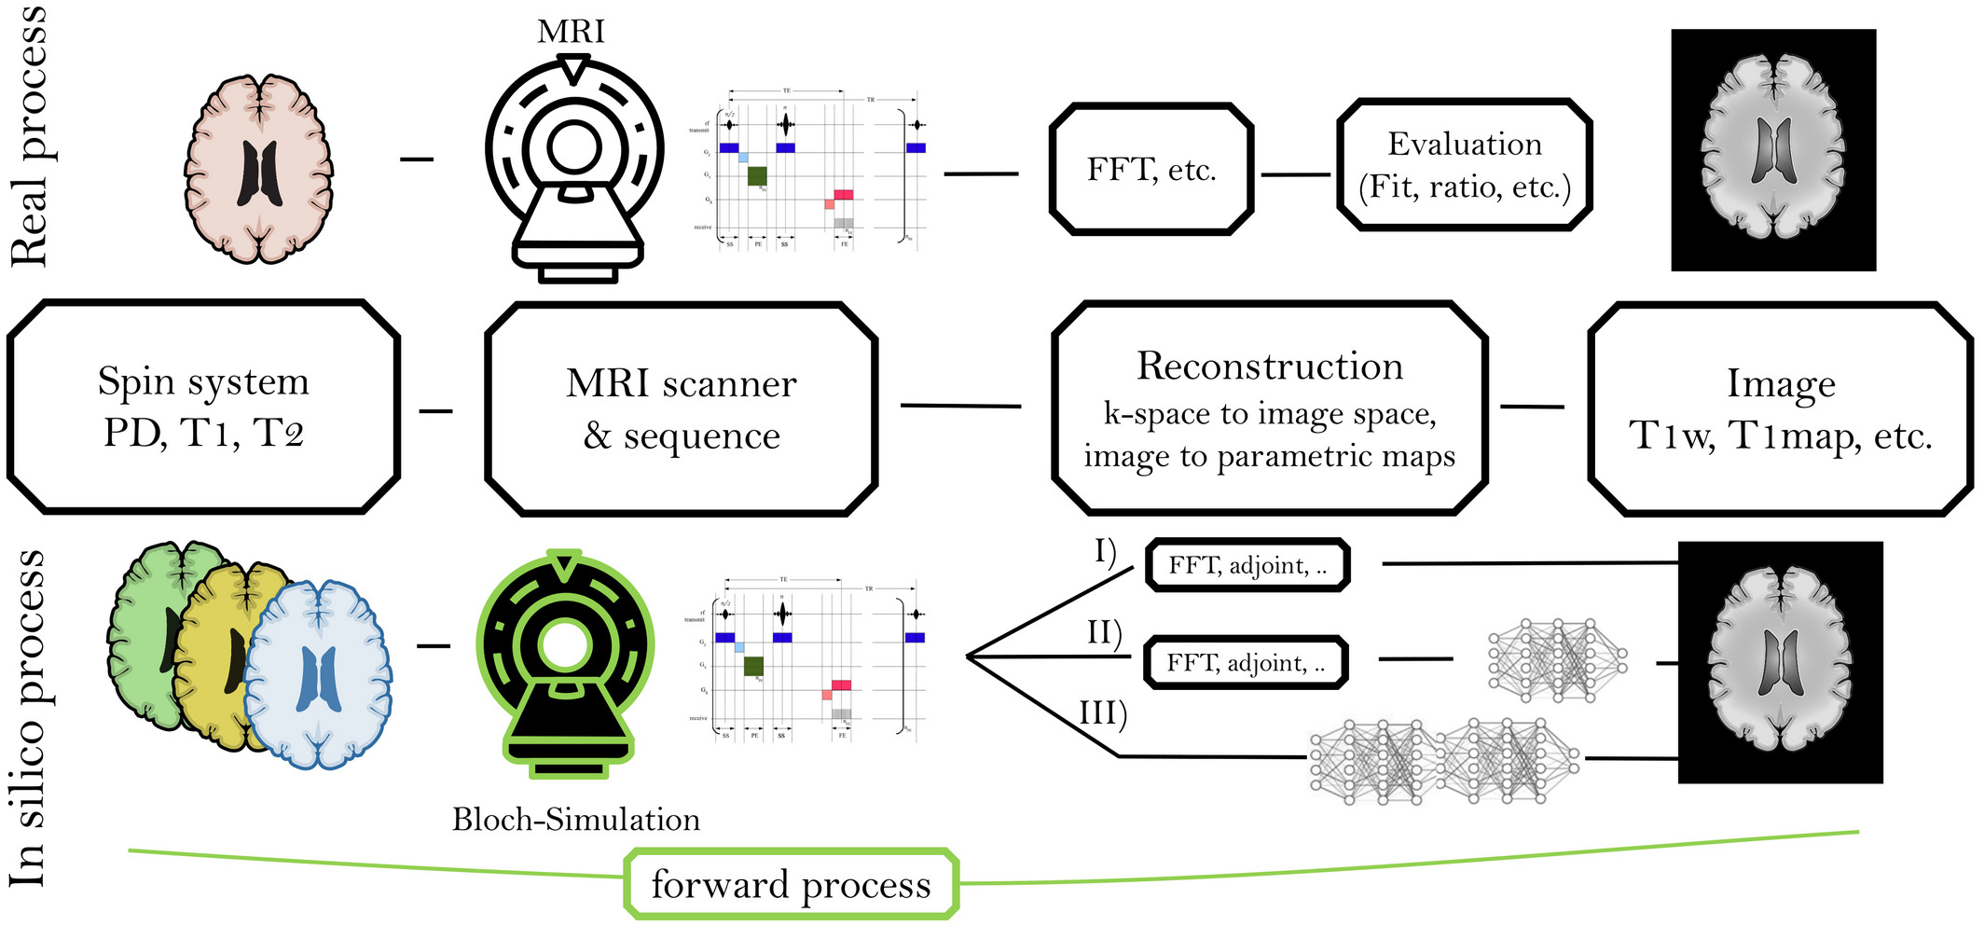
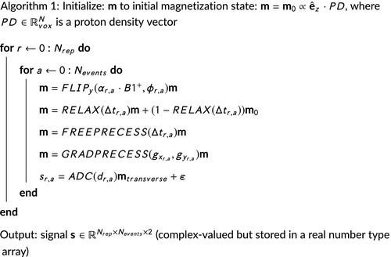
How does an MRI simulator work?
Inputs: seq and PD/T1/T2 -> Output: e.g. T1-weighted
Forward simulation uses the underlying physics of the MRI magnetization

Slide 9
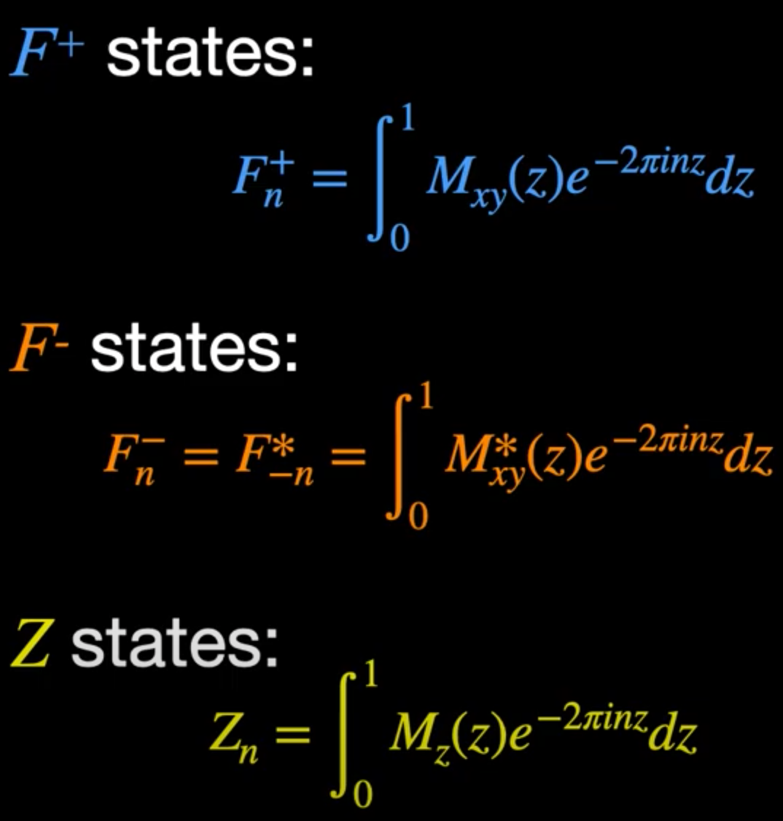
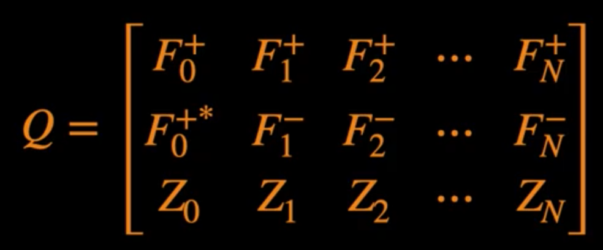
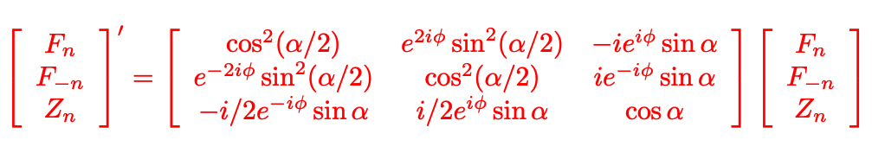
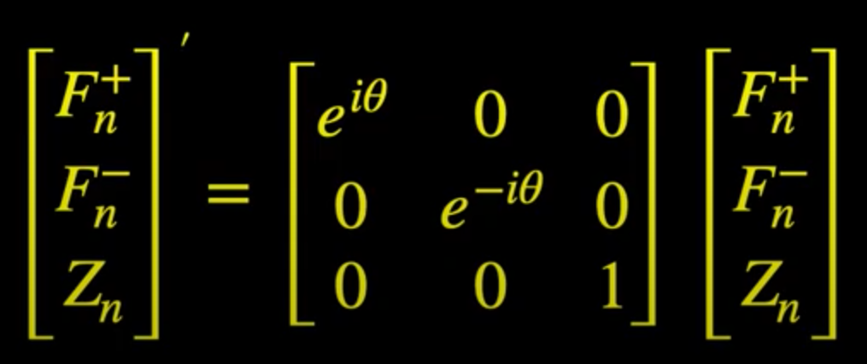
How is the magnetization simulated at each voxel?
We work with Extended Phase graphs:
A single voxel’s state is represented as a matrix of F states:
A pulse sequence is therefore modelled as a multiplication of several matrices corresponding to precession, RF rotations and gradients => can make it differentiable
A recent simulator (MRZero) by Zeiss et al 2021 is differentiable by design
Precession is multiplication by a diagonal matrix:
RF rotation is modelled with a rotation matrix
Gradients are simulated by linear shifts:
magnetization in F_{n} -> F_{n+1}
Can also be written in matrix form

Slide 10
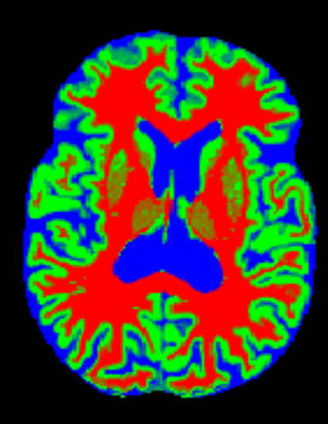
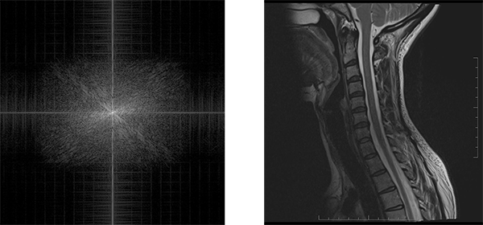
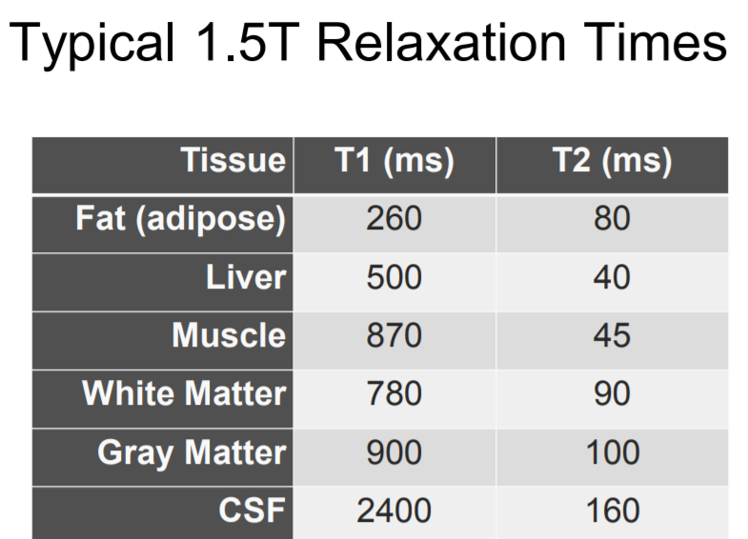
Our contribution: once you have a differentiable simulator, how do you optimize a digital phantom?
Digital phantom
Back-propagate the loss to the digital phantom
Inverse problem + ill-posed:
Forward process is a projection of the phantom on some space
Some MRI sequences are not sensitive to some tissues
T1/T2/PD
K-space
simulated T1-weighted
% GM
% WM
% CSF
MRI simulator
loss
Sequence params: TE, TR, flip angle, …
real T1-weighted

Slide 11
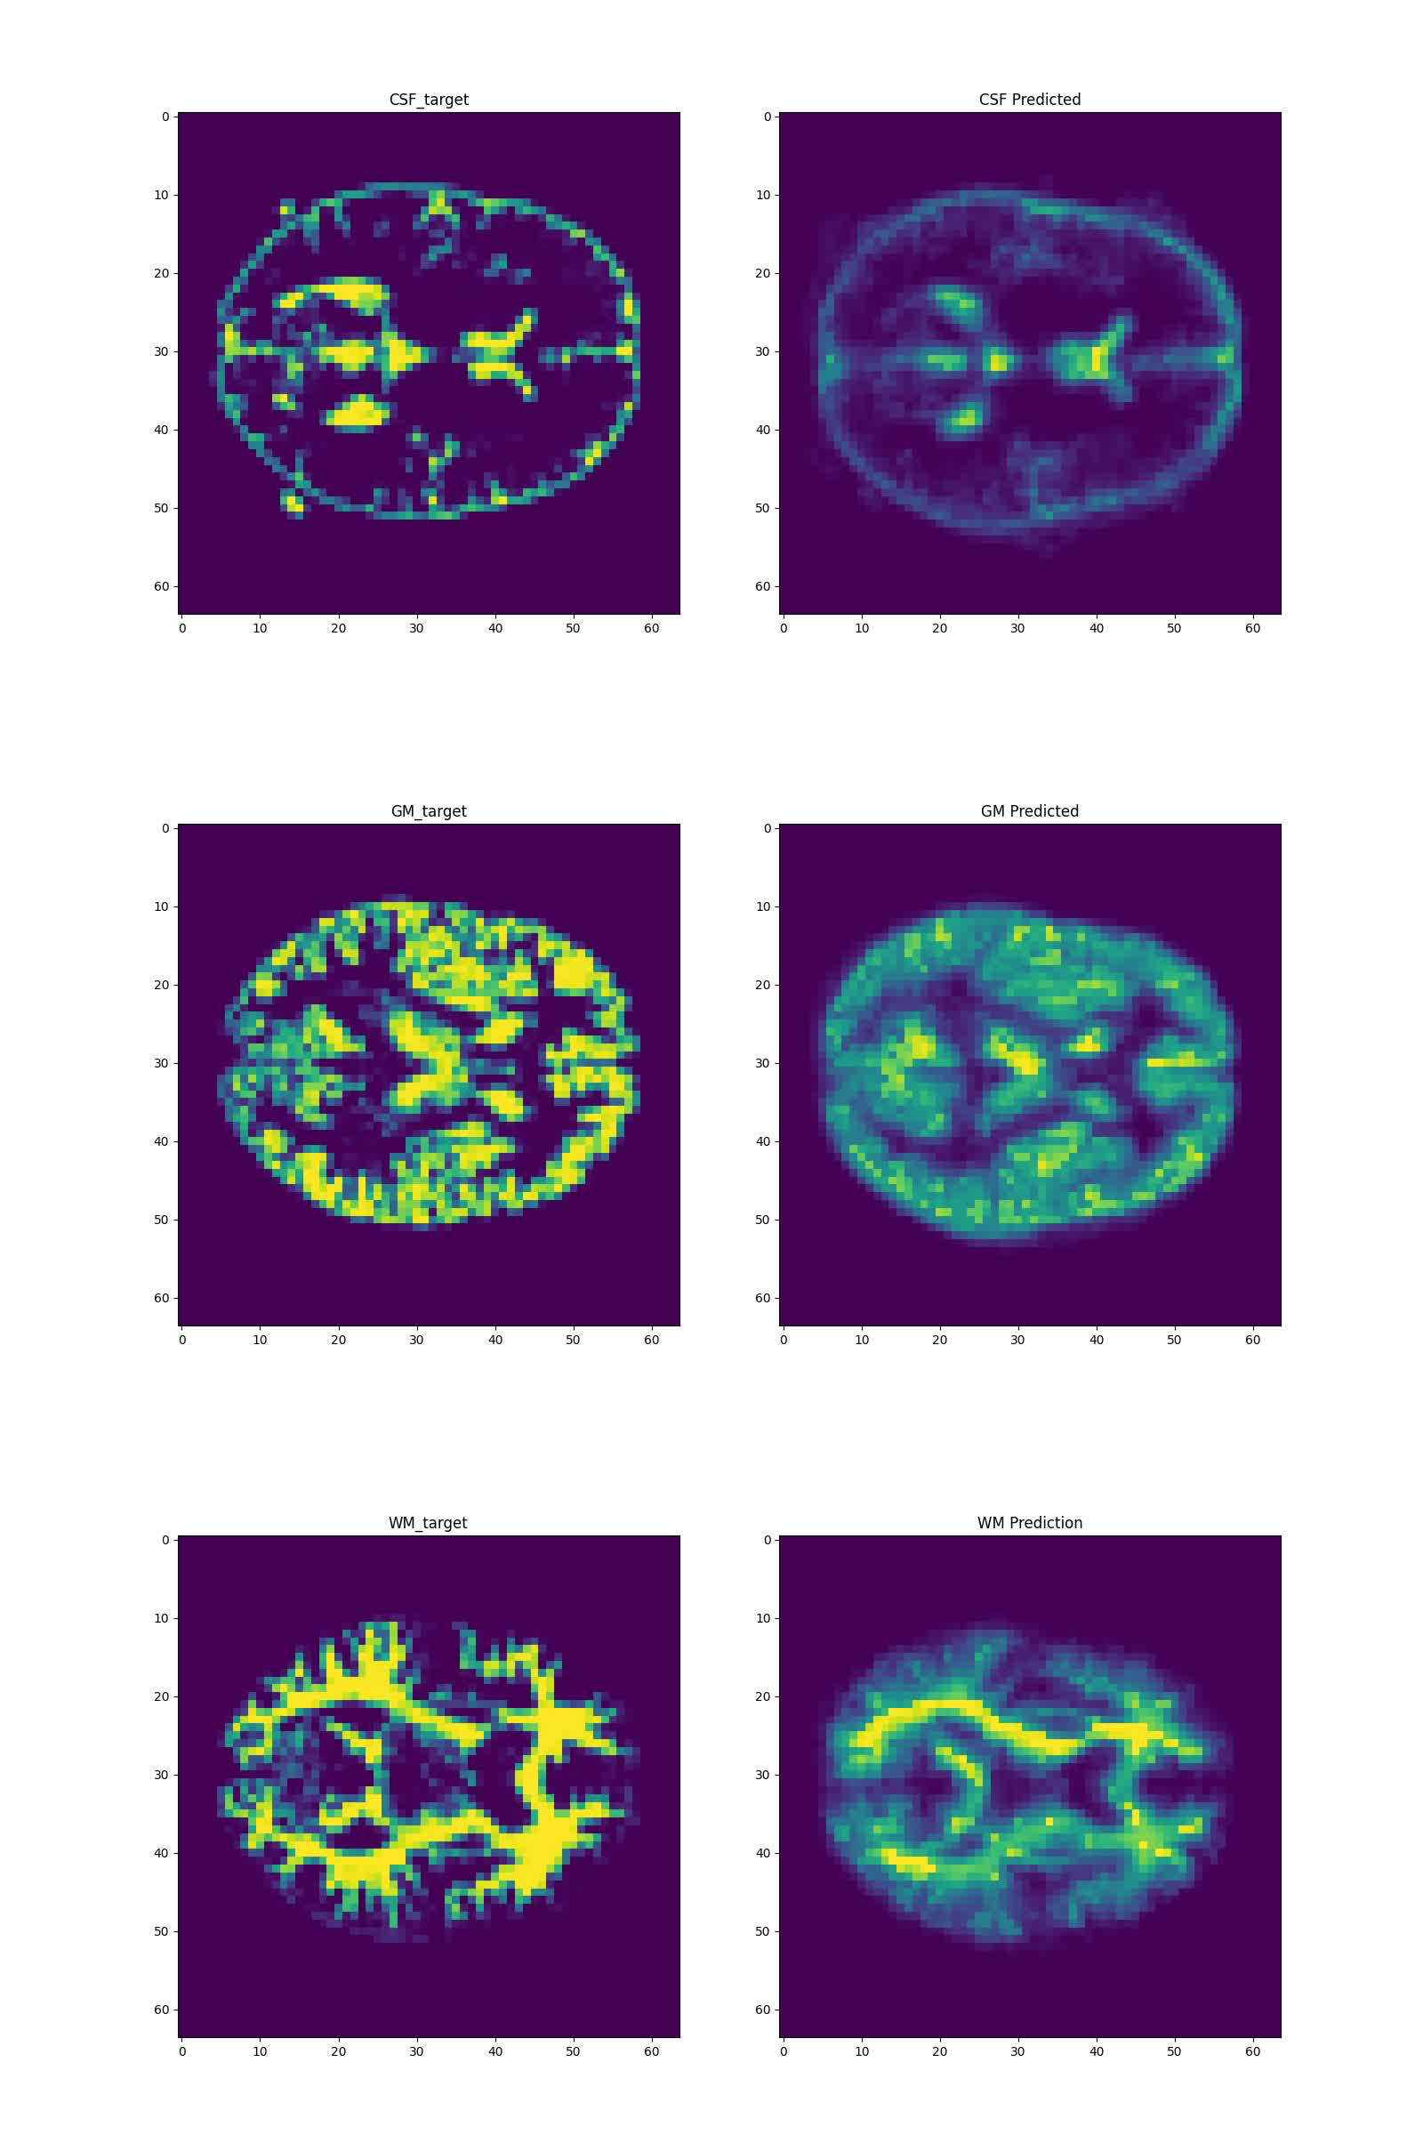
Results: we reconstructed patient-specific digital phantoms on the Brainweb dataset
This used 6 pulse sequences
Can do it with only 1 sequence also, but the problem becomes more ill-posed.

Slide 12
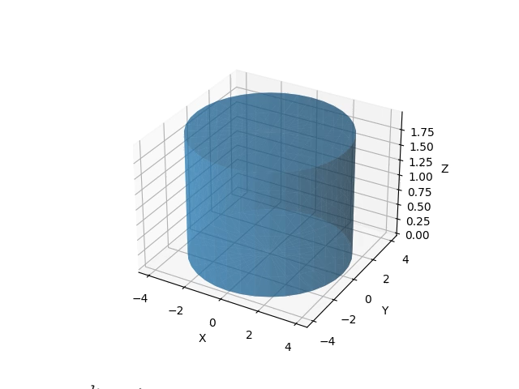
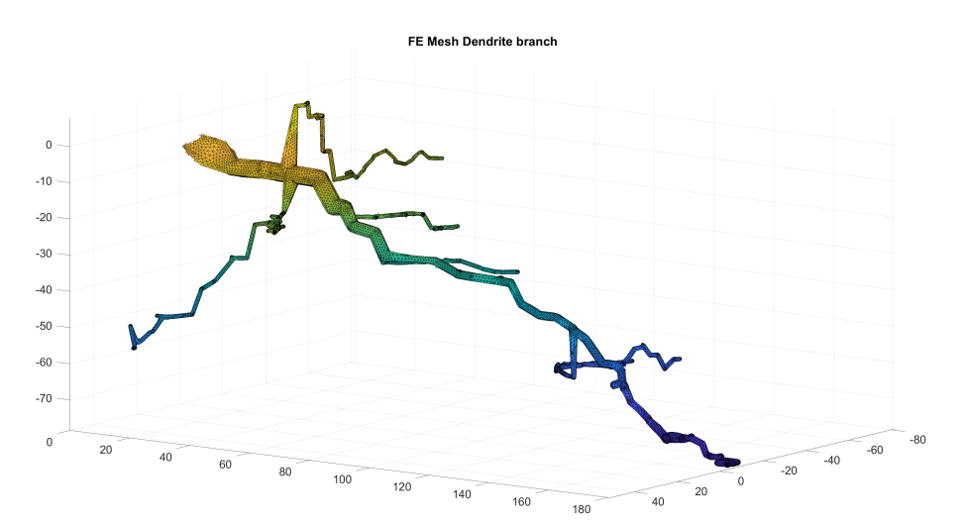
What about Diffusion MRI?
Diffusion MRI simulators exist (e.g. Disimpy, SpinDoctor), but none are differentiable
We are currently building a PDE-based diffusion MRI simulator that is differentiable (in PyTorch)

Slide 13
Part 2: Implicit representations

Slide 14
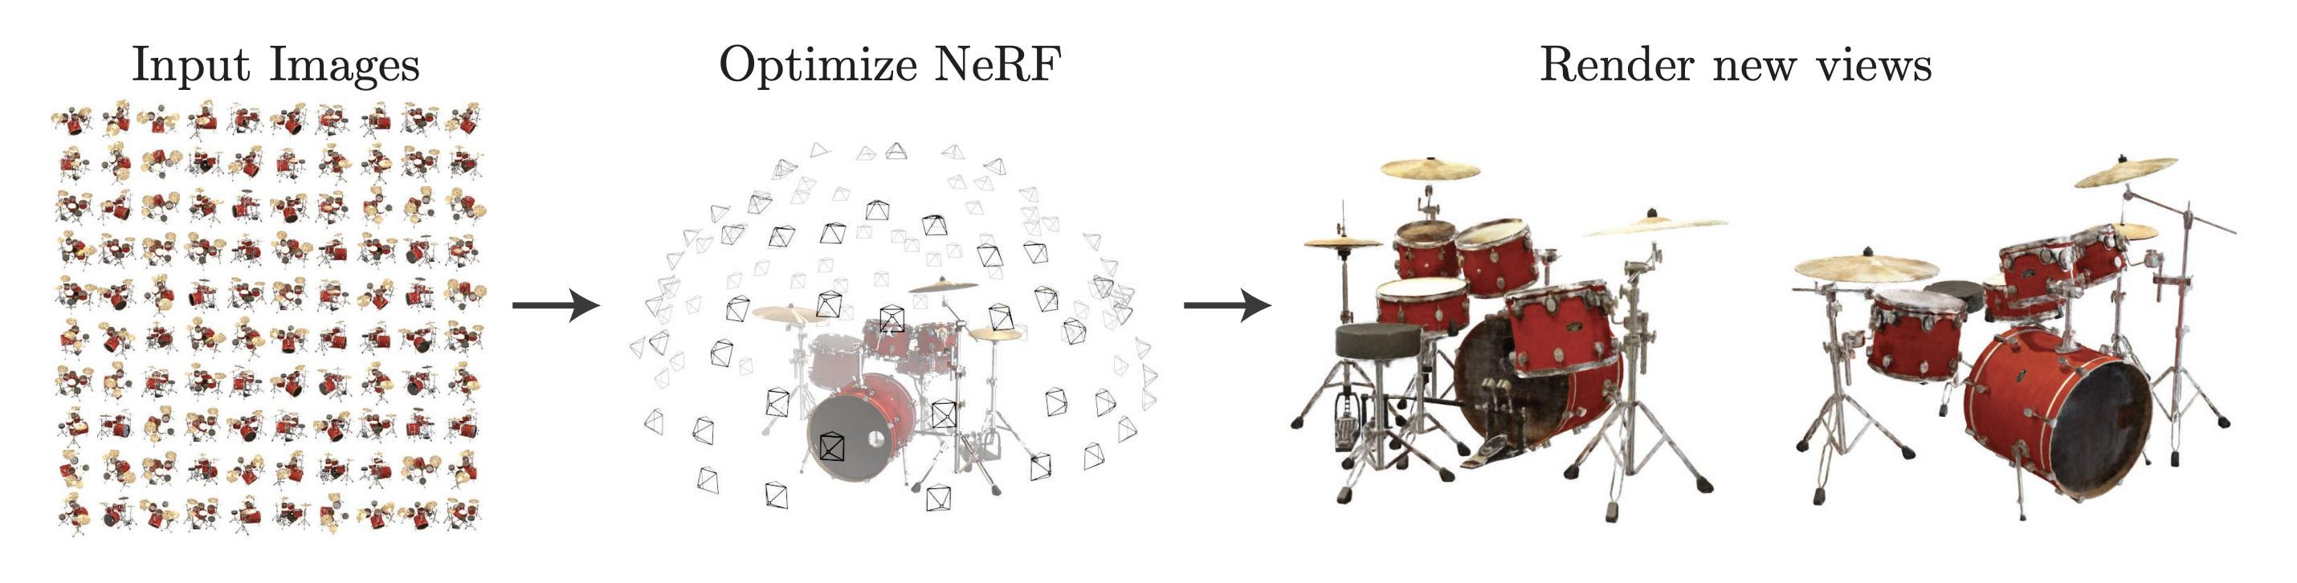

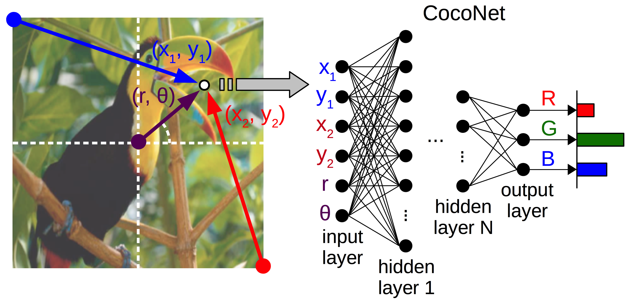
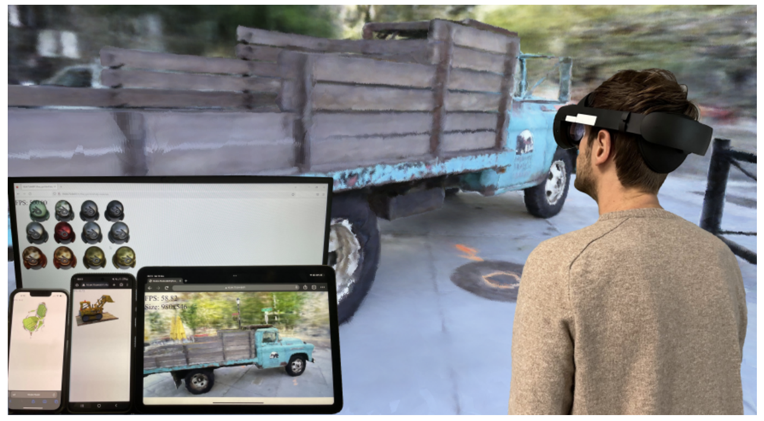
A recent discovery: coordinate networks can learn implicit representations of scenes and perform efficient, real-time rendering
NERF, Mildenhall, 2020
Real-time NERF rendering on mobile devices (Rojas, 2023)

Slide 15
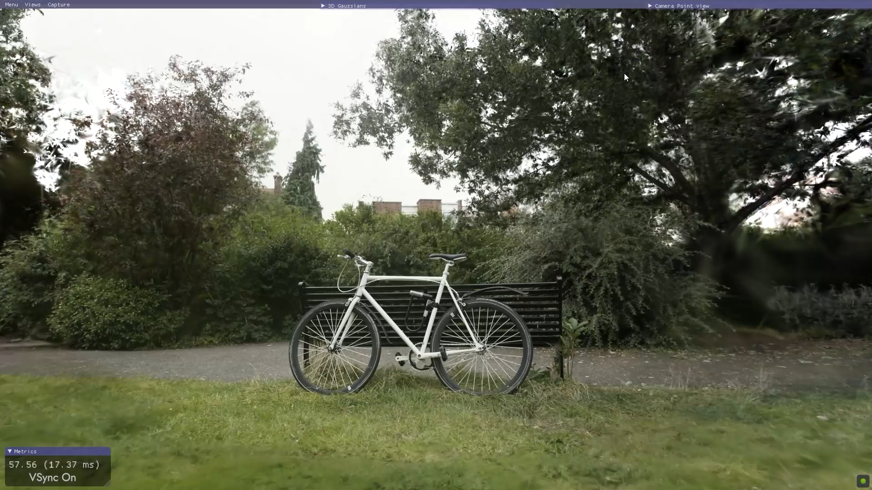
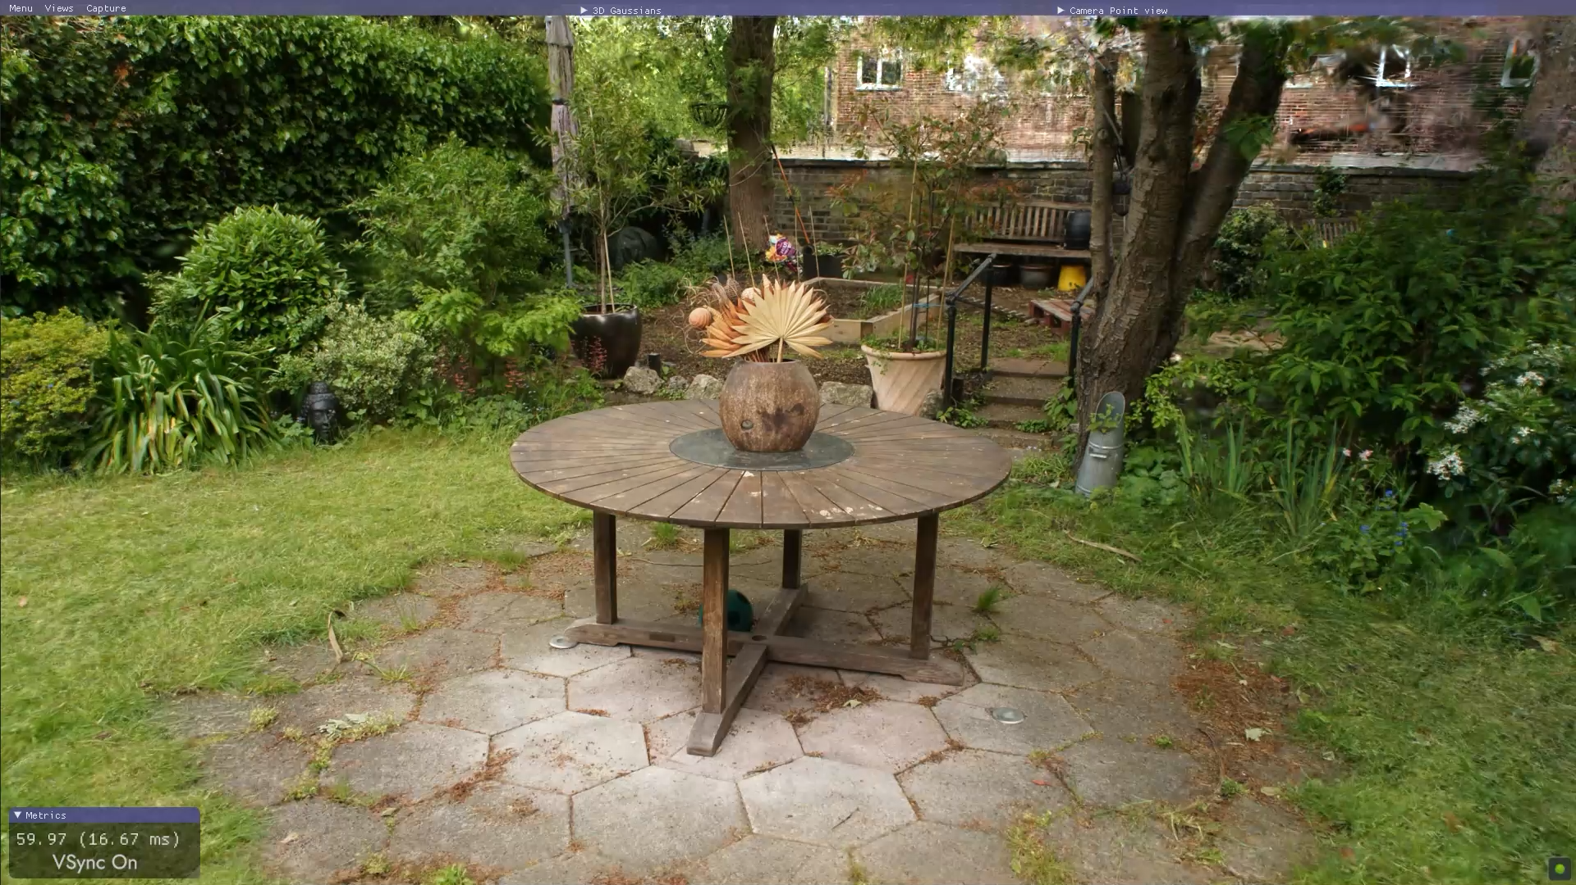
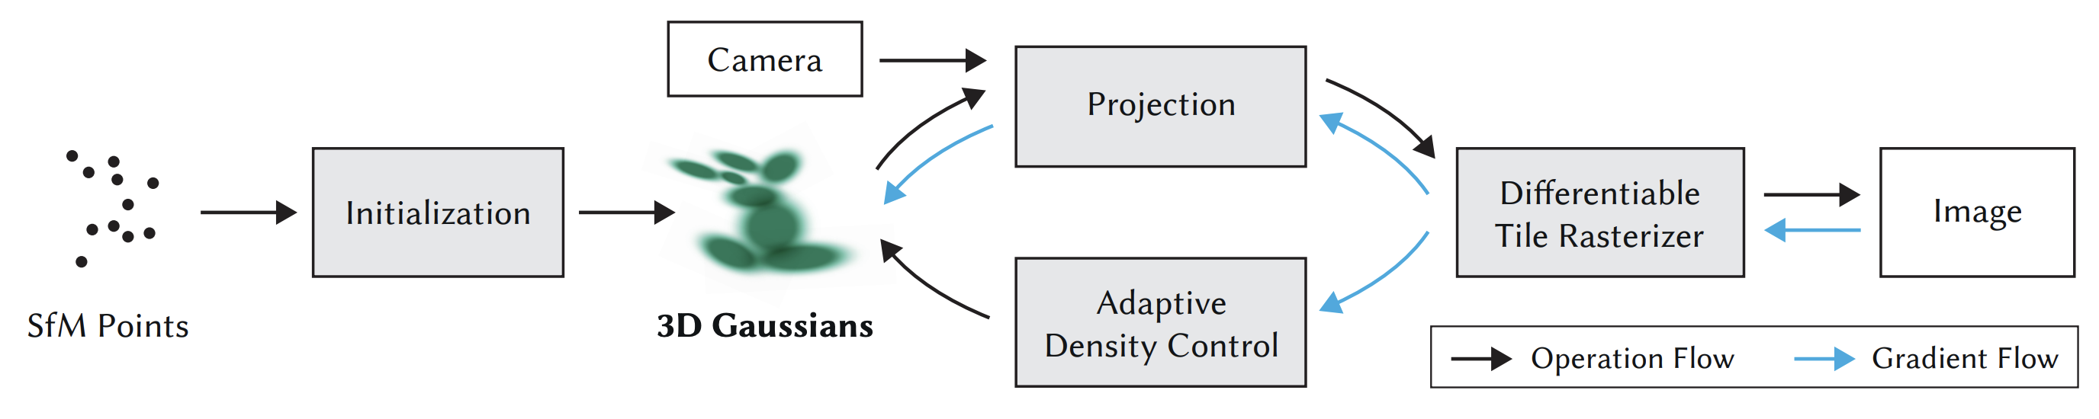
Gaussian Splatting is a very recent technique for 3D scene reconstruction

Slide 16
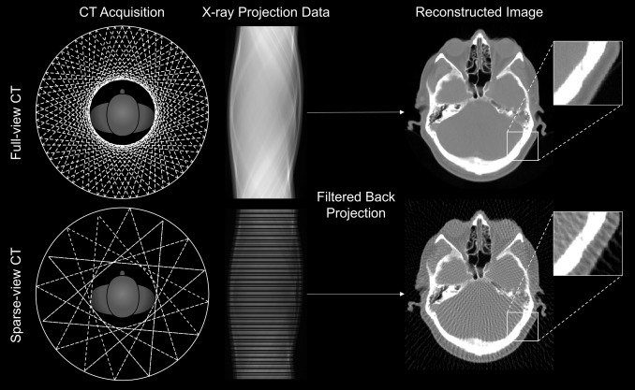
We built a Gaussian Splatting model for CT novel view synthesis
In CT we get projection views from multiple angles
Can we learn a Gaussian Splatting model from sparse-view CT?
Equivalent in computer graphics: few viewing angles of a 3D scene.

Slide 17
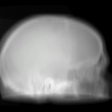
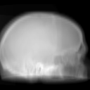
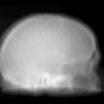
Results on Parkinson’s CT dataset (PPMI)
Gaussian Splatting (50% of views / 360) Standard ground truth (100%)
Ultra-low dose (10%)

Slide 18
Future directions

Slide 19
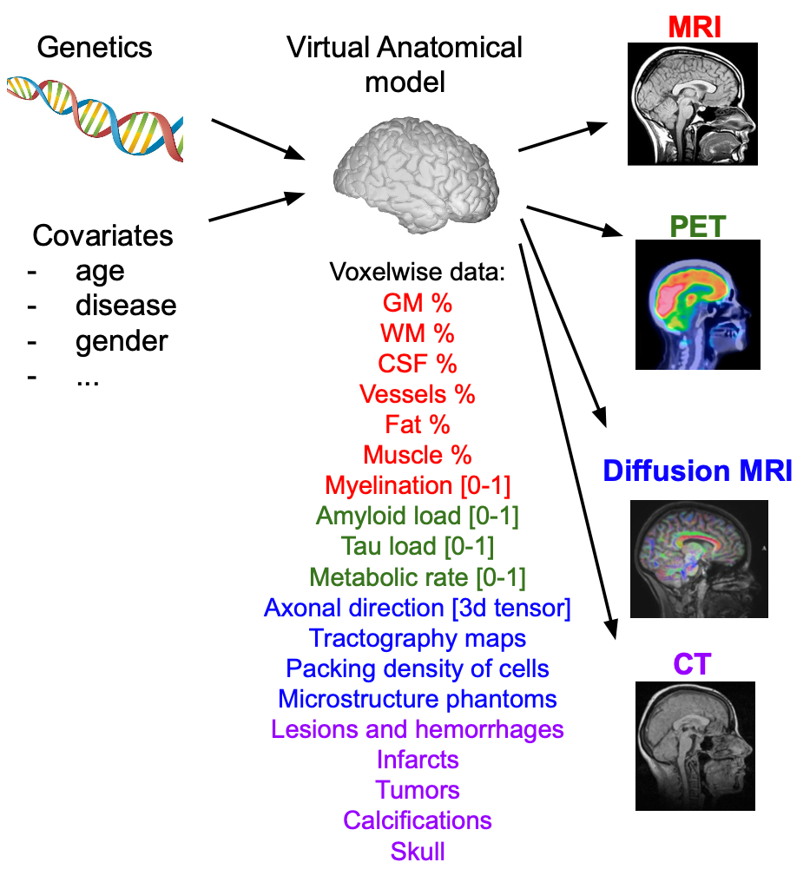
Extremely detailed, patient-specific digital brain phantoms
Derive phantoms for every subject in large brain datasets(ADNI, PPMI, AIBL)
Combine multiple modalities together: MRI, PET, CT, …

Slide 20
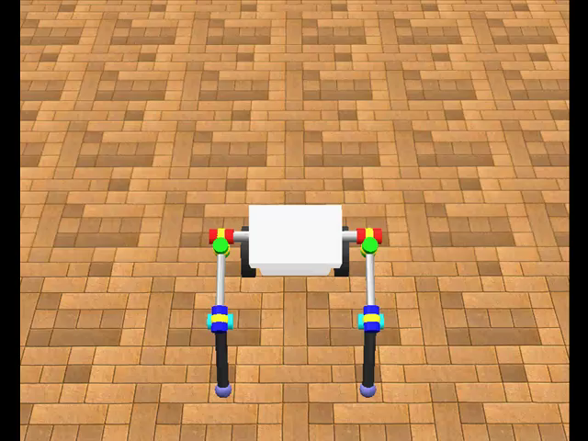
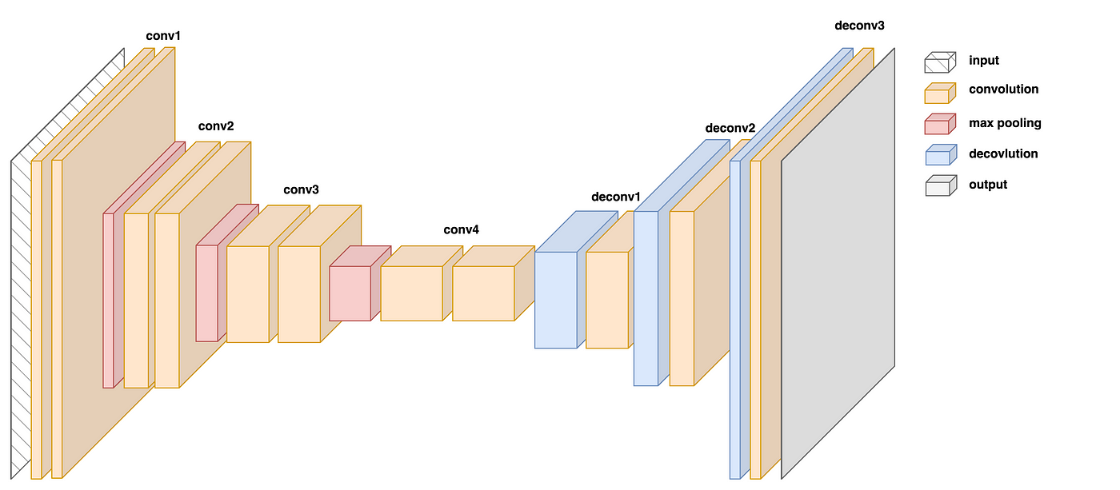
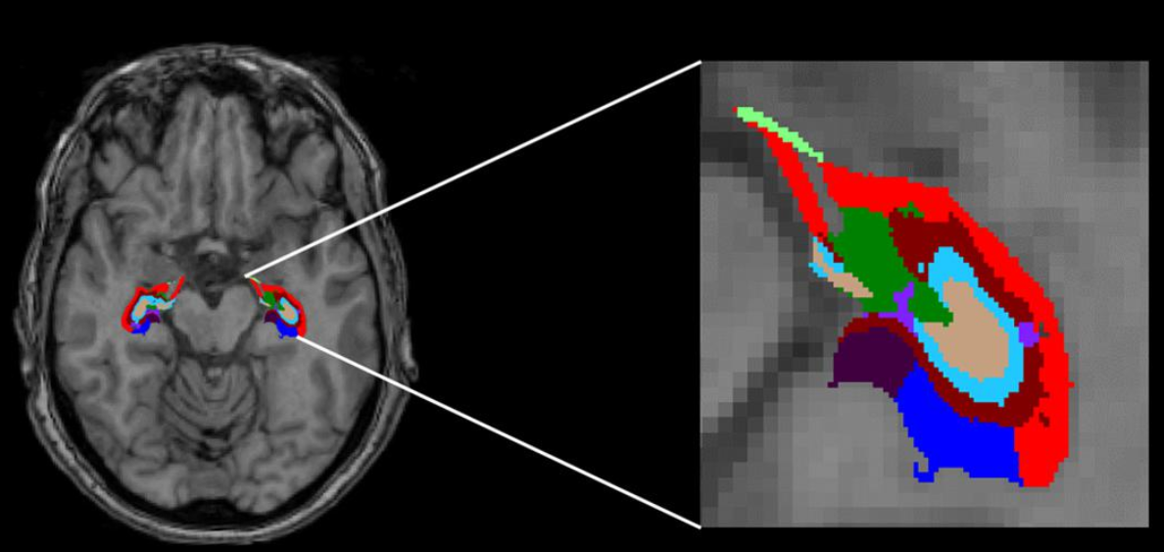
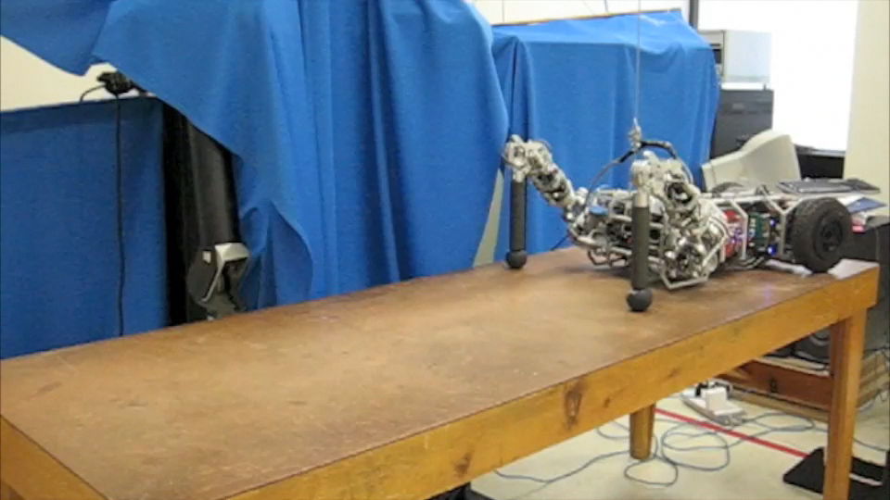
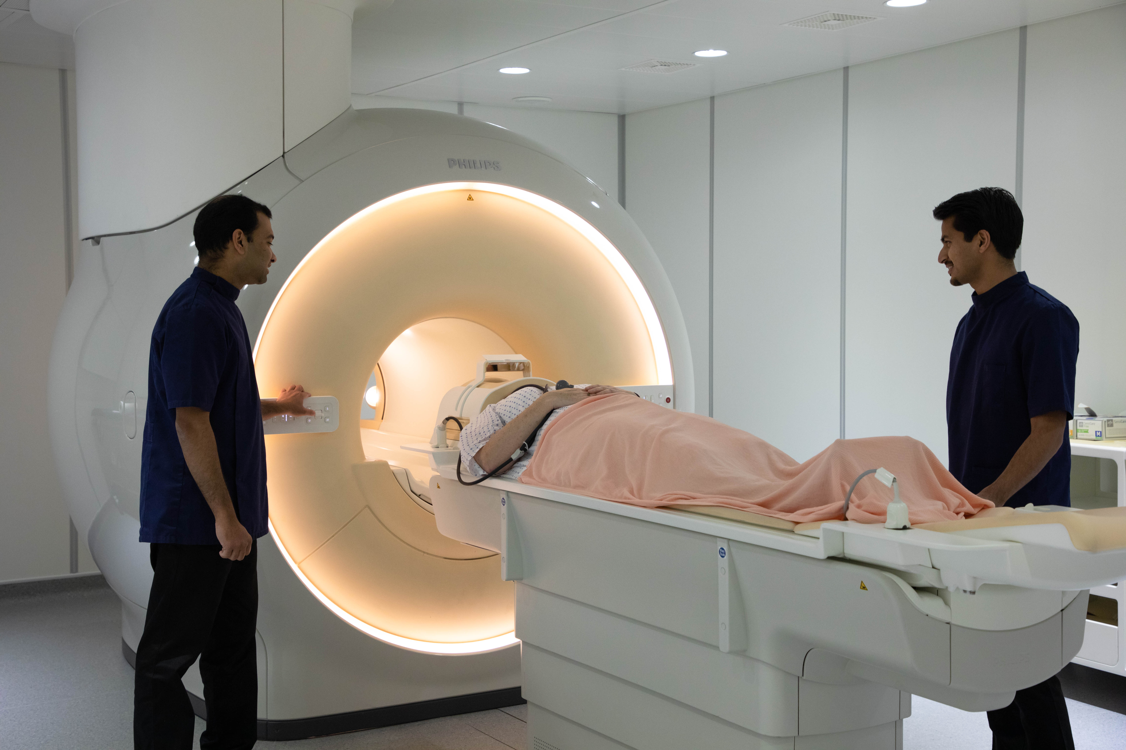
Optimize MRI sequence to achieve downstream task
Task: e.g. Hippocampal subfields segmentation, AD detection
T1/T2/PD
MRI simulator
Sequence params: TE, TR, flip angle, …

Slide 21
Compressed sensing using generative priors
Learn generative models (diffusion models) over the distribution of brain phantoms
Powerful compressed sensing using the generative model as a prior
=> Significant leap forward towards the MRI dream

